Slide 1
Extensions and Portlets
Modifying the OpenMRS interface

Slide 2

Modifying the interface
We can use new JSPs and OpenMRS tags in our modules to add new screens to OpenMRS
But what about modifying the existing screens? Adding items to existing menus?
OpenMRS provides two main mechanisms for modifying the interface...
Extensions
Portlets

Slide 3
Extension points
Extensions are classes which a module can define to output something to the view
Extension points are "hooks" in the standard OpenMRS JSPs that extensions can be attached to
So a module can define an extension, attach it to an existing extension point and output something at that location

Slide 4

Example: help extension
There is an extension point on the help page /WEB-INF/view/help.jsp
This a unique identifier for this point
...
<spring:message code="help.text2"/>
<br/>
<openmrs:extensionPoint pointId="org.openmrs.help" />
<%@ include file="/WEB-INF/template/footer.jsp" %>

Slide 5
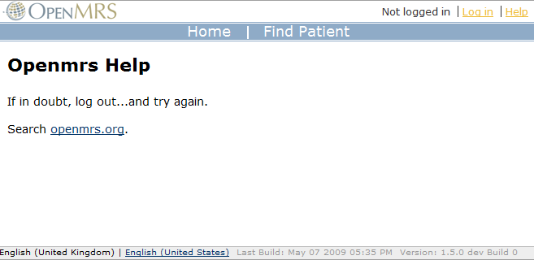
Example: help extension
We can use this to put HTML under the standard help page messages, i.e.
Extension point is here, so we can add HTML here

Slide 6
Example: help extension
We start by creating the extension class, which must extend the abstract class org.openmrs.module.Extension
public class HelpExt extends Extension {
public MEDIA_TYPE getMediaType() {
return MEDIA_TYPE.html;
}
}
Every extension must implement this method, and return MEDIA_TYPE.html ... because one day extensions might have different media types...

Slide 7
Example: help extension
The extension outputs HTML by overriding getOverrideContent
public class HelpExt extends Extension {
public MEDIA_TYPE getMediaType() {
return MEDIA_TYPE.html;
}
public String getOverrideContent(String bodyContent) {
return "<b>Help yourself!</b>";
}
}
This content will appear at the extension point in the JSP

Slide 8
Example: help extension
The extension is hooked to the extension point in the module's config.xml file...
The extension point ID from the JSP
<module>
...
<extension>
<point>org.openmrs.help</point>
<class>@MODULE_PACKAGE@.HelpExt</class>
</extension>
...
</module>
The extension class in our module

Slide 9
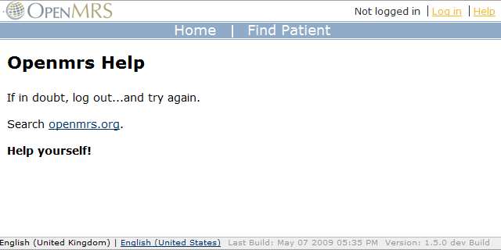
Example: help extension
If getOverrideContent in the extension class returns non-null, the returned string is simply outputted...
Extension HTML has been output here

Slide 10

Extension classes
So the most basic extensions, simply return HTML, and this is displayed at the extension point
However, in order to ensure consistent styling of HTML, some extension points call methods on attached extensions and expect data, rather than actual HTML
OpenMRS defines several extension classes which we can extend to provide extensions with the required methods

Slide 11
Extension classes
For example, the extension point org.openmrs.headerFullIncludeExt expects extensions which extend HeaderIncludeExt, and thus provide a method to return a list of file paths
/WEB-INF/template/headerFull.jsp
...
<openmrs:extensionPoint pointId="org.openmrs.headerFullIncludeExt"
requiredClass="org.openmrs.module.web.extension.HeaderIncludeExt">
<c:forEach var="file" items="${extension.headerFiles}">
<openmrs:htmlInclude file="${file}" />
</c:forEach>
</openmrs:extensionPoint>
Will call getHeaderFiles on the extension object

Slide 12
Extension classes
Thus to create a 'header include' extension, don't override getOverrideContent, but implement getHeaderFiles instead, e.g.
public class MyHeaderIncludeExt extends HeaderIncludeExt {
public List<String> getHeaderFiles() {
ArrayList<String> files = new ArrayList<String>();
files.add("/moduleResources/mymodule/myscript.js");
return files;
}
}

Slide 13
Extension classes
OpenMRS defines the following extension classes...
AdministrationSectionExt - adds links to the administration page
BoxExt - adds a box to the patient overview
LinkExt - returns a link with label, URL and required privilege
LinkProviderExt - returns a list of links
PatientDashboardTabExt - adds a new tab to the patient dashboard
PortletExt - returns a portlet URL
TableRowExt - returns a table row

Slide 14
Reusable components
We've already learnt 3 ways to create reusable components to use in OpenMRS
Simple .jsp include
Tag file
Tag handler class
For example, we want to create a reusable component which is a table of patient appointments.........

Slide 15


JSP include
Simplest way is to put the HTML for the table in a separate JSP, e.g.
Requests home.htm
Sends HTML response
Forwards to controller
Returns HTML
Loads appointments
from database
class HomeController {}
Loads home.jsp
Gets parsed JSP
<c:forEach items="appointments">
...
</c:forEach>
<html>
<body>
...
<%@ include file="appointments.jsp"%>
</body>
Includes
appointments.jsp

Slide 16
TAG files
This is very similar...
Requests home.htm
Sends HTML response
Forwards to controller
Returns HTML
Loads appointments
from database
class HomeController {}
Loads home.jsp
Gets parsed JSP
<c:forEach items="appointments">
...
</c:forEach>
<html>
<body>
...
<customTags:appointments />
</body>
Includes
appointments.tag

Slide 17
Tag handler class
Using a Java class to generate the HTML for the component
Can now load the data in that class
Requests home.htm
Sends HTML response
Forwards to controller
Returns HTML
class HomeController {}
Loads appointments
from database
Loads home.jsp
Gets parsed JSP
class AppointmentsTag {
...
}
<html>
<body>
...
<customTags:appointments />
</body>
calls doTag()
Sends HTML

Slide 18
Issues
The obvious disadvantage of the JSP include and TAG file is that the data has to be loaded in the page's controller... not so reusable
The tag handler class allows us to move the data loading, but this won't be using MVC architecture
What if we need an easy way of overriding components on existing pages?
Introducing portlets...

Slide 19

Portlets
Portlets are pluggable user interface components
They are like independent pages, within a page
Have a URL
Have their own controllers
Use their own models

Slide 20
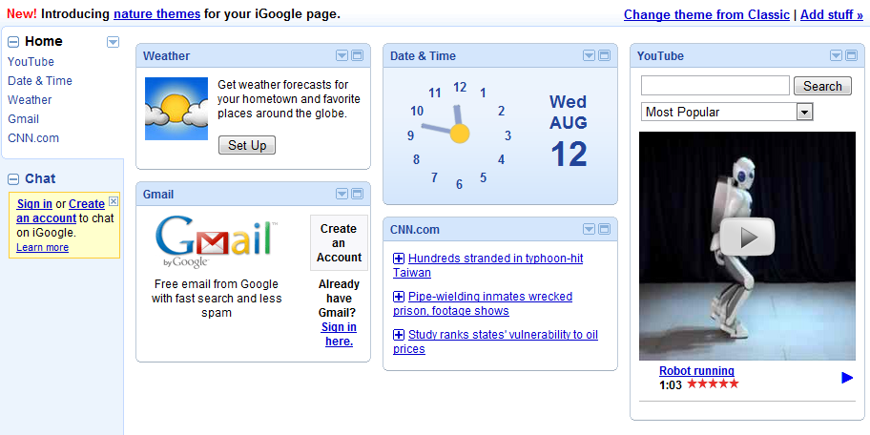
Example: iGoogle
Portlets

Slide 21
Portlet
Requests home.htm
Sends HTML response
Requests
appointments.portlet
Forwards
Returns HTML
Forwards
Returns HTML
AppointmentsPortletController
class HomeController {}
Loads appointments
from database
Returns HTML
Loads home.jsp
Gets parsed JSP
class PortletTag {
...
}
<html>
...
<openmrs:portlet url="appoinments" />
</body>
</html>
calls doTag()
Sends HTML

Slide 22
Portlets
Disadvantages
Complicated!!!!
Advantages
Have their own controller and model - keeps their data and logic separate from the page's
Are fetched by a URL using a server request - therefore can be overridden just by overriding the URL

Slide 23
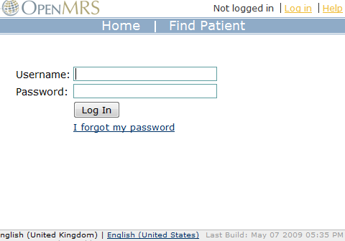
Example: login portlet
login.jsp
...
<openmrs:portlet url="login"/>
...
portlet tag is handled
by PortletTag
login.htm

Slide 24
login
Gets url attribute
PortletTag.java
/portlets/login.portlet
Creates portlet URL
Requests portlet URL
urlMapping
*.portlet → PortletController
Maps URL
to controller
openmrs-servlet.xml
/portlets/login.portlet
Gets servlet_path
attribute
PortletController.java
/portlets/login
Removes .portlet
Forwards to view...
jspViewResolver
/portlets/login → /portlets/login.jsp
Maps view
to JSP
openmrs-servlet.xml
login.jsp
Displays JSP!

Slide 25
Adding a module portlet...
Create a controller which extends PortletController
Override populateModel to create the model for the portlet
Add a bean instance of the controller to the module's application context, e.g.
<bean
id="patientAppointmentsPortletController"
class="org.....web.controller.PatientAppointmentsPortletController"
/>

Slide 26
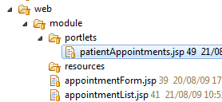
Adding a module portlet...
Add an entry to the URL mapping bean to map the portlet's URL to the controller, e.g.
Place the JSP for the portlet in /web/module/portlets
<property name="mappings">
<props>
<prop key="module/@MODULE_ID@/appointment.form">appointmentFormController</prop>
<prop key="module/@MODULE_ID@/appointment.list">appointmentListController</prop>
<prop key="**/patientAppointments.portlet">patientAppointmentsPortletController</prop>
</props>
</property>

Slide 27
Using a module portlet...
To use a portlet from a module you need to specify in the portlet tag which module it is defined in
This allows the portlet controller to find the portlet's JSP
For example:
<openmrs:portlet
url="patientAppointments"
moduleId="appointments"
/>

Slide 28
Overriding portlets
URLs for controllers in OpenMRS can be overridden by modules
Put a mapping in the url mapping bean for that module, e.g.
<bean class="org.spring...SimpleUrlHandlerMapping">
<property name="order">
<value>50</value>
</property>
<property name="mappings">
<props>
<prop key="/login.htm">customLoginPage</prop>
</props>
</property>
</bean>
Tells spring that these mappings take priority over OpenMRS's
Overrides the login URL, mapping it to our controller

Slide 29
Overriding portlets
Portlets are imported by PortletTag via a URL
So we can override them by overriding their URL, redirecting it to a controller in our module, e.g.
<bean class="org.spring...SimpleUrlHandlerMapping">
<property name="order">
<value>50</value>
</property>
<property name="mappings">
<props>
<prop key="/portlets/login.portlet">customLoginPortlet</prop>
</props>
</property>
</bean>
Overrides the login portlet, mapping it to our portlet controller

Slide 30
References
Websites
http://openmrs.org/wiki/Module_Extension_Points
http://openmrs.org/wiki/Module_Portlets

